Slide 1
Polymorphism

Slide 2
Objectives
Overloading and Overriding
Interface
Abstract class

Slide 3
Polymorphism
Ability allows many versions of a method based on overloading and overriding methods techniques.
Overloading: A class can have some methods which have the same name but their parameter types are different.
Overriding: A method in the father class can be overridden in its derived classes (body of a method can be replaced in derived classes).

Slide 4
Overloading
overloading with constructors public Rectangle(){…}
public Rectangle(int length, int width){… }
Overloading also extends to general methods. public void setValue(int len){ length= (len>0)?1:0; } public void setValue (int len, int wi){ length= (len>0)? 1: 0; width= (wi>0)? wi:0; }
Rectangle
# length: int # width: int
+ Rectangle(); + Rectangle(int, int) + setValue(int): void + setValue(int, int): void

Slide 5
Overriding
Rectangle
# length: int # width: int
+ Rectangle(); + Rectangle(int, int) + setValue(int ):void + setValue(int ,int ):void + toString(): String
Box
Height: int
+ Box(); + Box(int, int, int) + toString(): String + set(int, int, int ): void

Slide 6
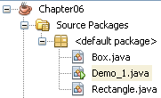
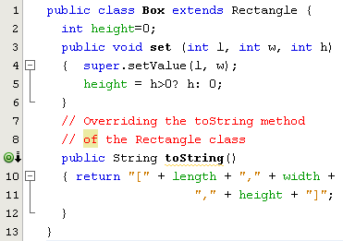
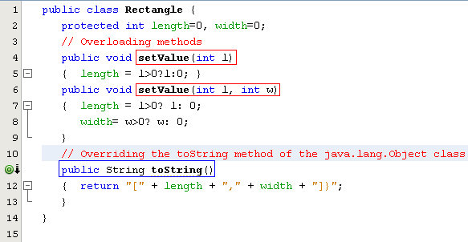

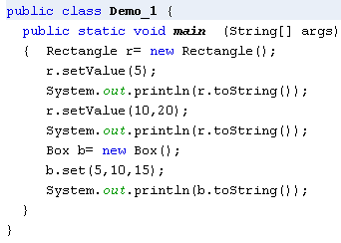
Overriding Inherited Methods
Overridden method: An inherited method is re-written
Overloaded methods: Methods have the same name but their parameters are different in a class

Slide 7
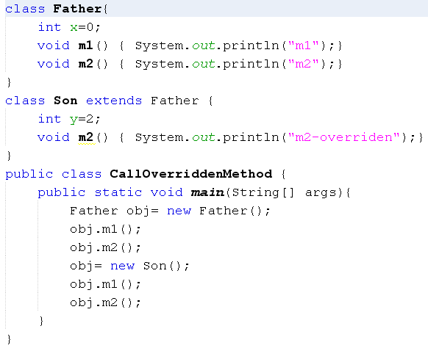
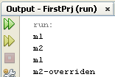
How Can Overridden Method be Determined?

Slide 8
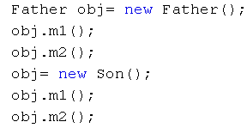
How Can Overridden Methods be Determined?
Son(declaration)
int y=2
Method Table
(m1, 600)
(m2, 800)
800
m2()
700
Father(declaration)
int x=0
Method Table
(m1, 600)
(m2, 650)
Class: 700
Class: 500
y=2
8000
x=0
9000
x=0
650
m2()
600
m1()
obj: 8000
obj: 9000
500
obj.m1();
obj.m2();
obj.m1();
obj.m2();
Classes are loaded to static heap

Slide 9
Interfaces
An interface is a reference type, similar to a class, that can contain only constants, initialized fields, prototypes (abstract methods, default methods), static methods, and nested types.
It will be the core of some classes
Interfaces cannot be instantiated because they have no-body methods.
Interfaces can only be implemented by classes or extended by other interfaces.

Slide 10
WHY AND WHEN TO USE INTERFACES?
To achieve security - hide certain details and only show the important details of an object (interface).
Java does not support "multiple inheritance" (a class can only inherit from one superclass). However, it can be achieved with interfaces, because the class can implement multiple interfaces

Slide 11
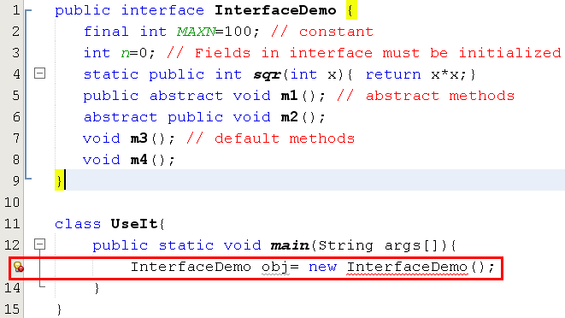

Interfaces…

Slide 12
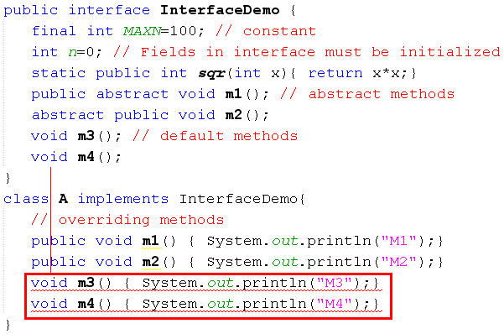
Interfaces…
m3(), m4() in A cannot implement m3(), m4() in InterfaceDemo, attempting to assign weaker access privileges, were public
Default methods of an interface must be overridden as public methods in concrete classes.

Slide 13
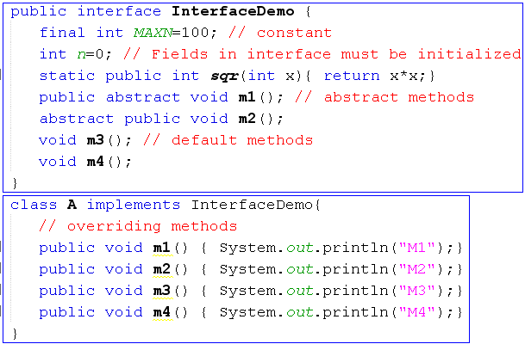
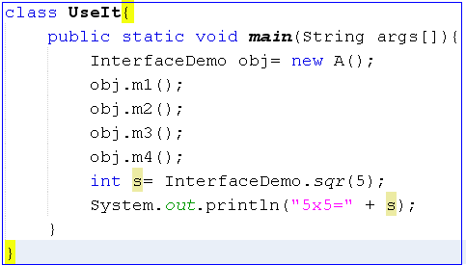
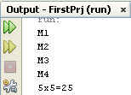
Interfaces…

Slide 14
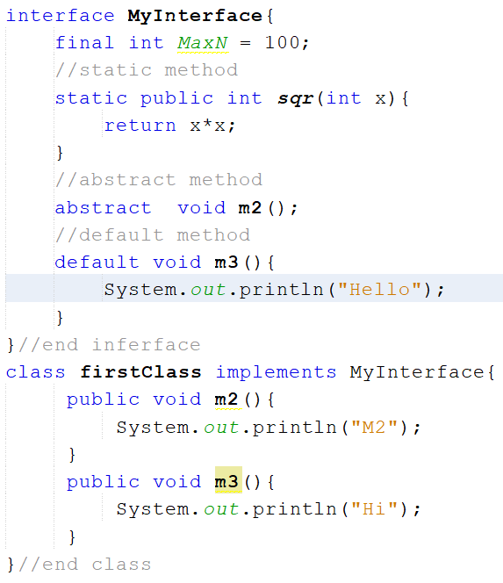
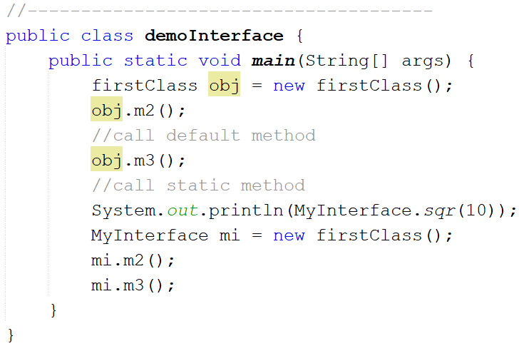
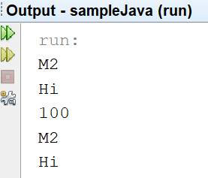

Slide 15
Abstract Classes
Used to define what behaviors a class is required to perform without having to provide an explicit implementation.
It is the result of so-high generalization
Syntax to define a abstract class
public abstract class className{ ... }
It isn’t necessary for all of the methods in an abstract class to be abstract.
An abstract class can also declare implemented methods.

Slide 16
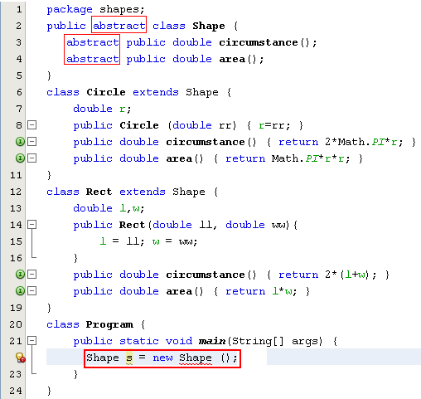
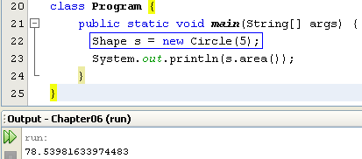
Abstract Classes…
Modified
Notes:
Shape s = new Circle(5);
System.out.println(s.area());
s = new Rect(10,5);
System.out.println(s.area());
---------------------------

Slide 17
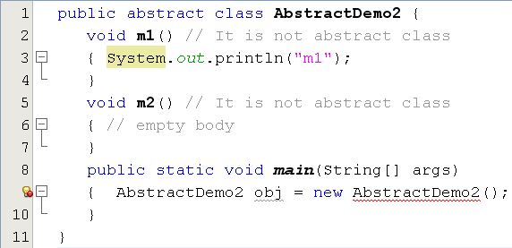
Abstract Classes…
This class have no abstract method but it is declared as an abstract class. So, we can not initiate an object of this class.

Slide 18
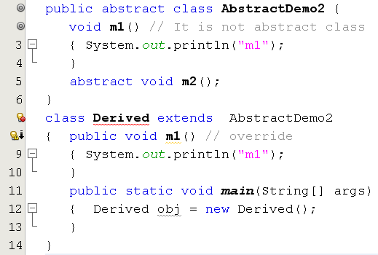
Abstract Classes…
Error. Why?

Slide 19
Implementing Abstract Methods
Derive a class from an abstract superclass, the subclass will inherit all of the superclass’s features, all of abstract methods included.
To replace an inherited abstract method with a concrete version, the subclass need merely override it.
Abstract classes cannot be instantiated

Slide 20
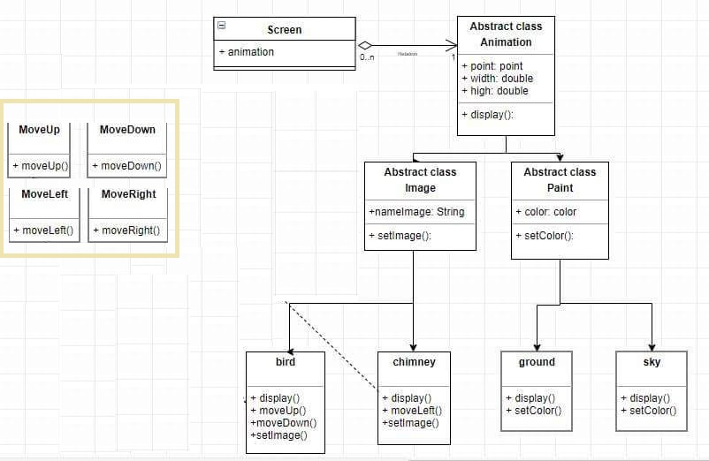
Example

Slide 21
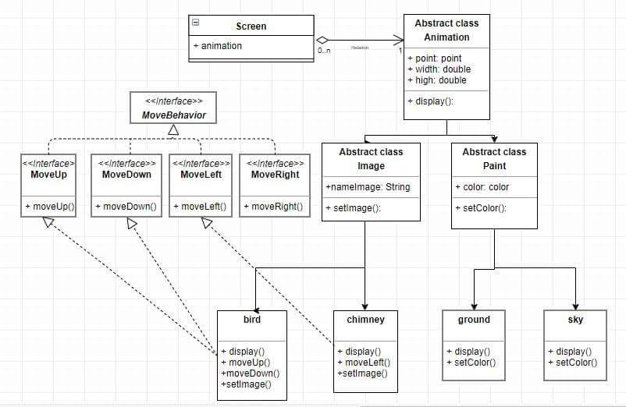
Example

Slide 22
Anonymous Classes
Anonymous classes are classes which are not named but they are identified automatically by Java compiler.
Where are they? They are identified at initializations of interface/abstract class object but abstract methods are implemented as attachments.
Why are they used?
Enable you to make your code more concise.
Enable you to declare and instantiate a class at the same time.
They are like local classes except that they do not have a name.
Use them if you need to use a local class only once.

Slide 23
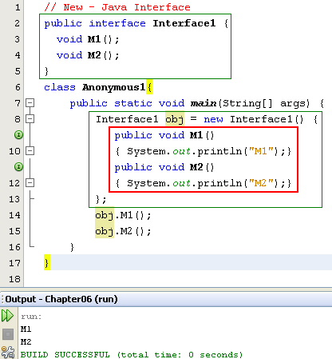

Anonymous Class…
Anonymous class.
Class name is given by the compiler:
ContainerClass$Number

Slide 24
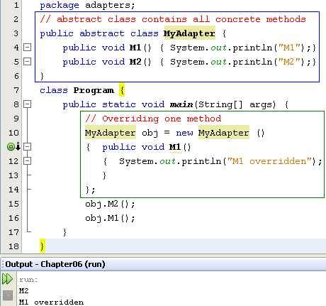
Anonymous Class…
Concrete methods but they can not be used because the class is declared as abstract one.
The abstract class can be used only when at least one of it’s methods is overridden
Anonymous class is a technique is commonly used to support programmer when only some methods are overridden only especially in event programming.

Slide 25
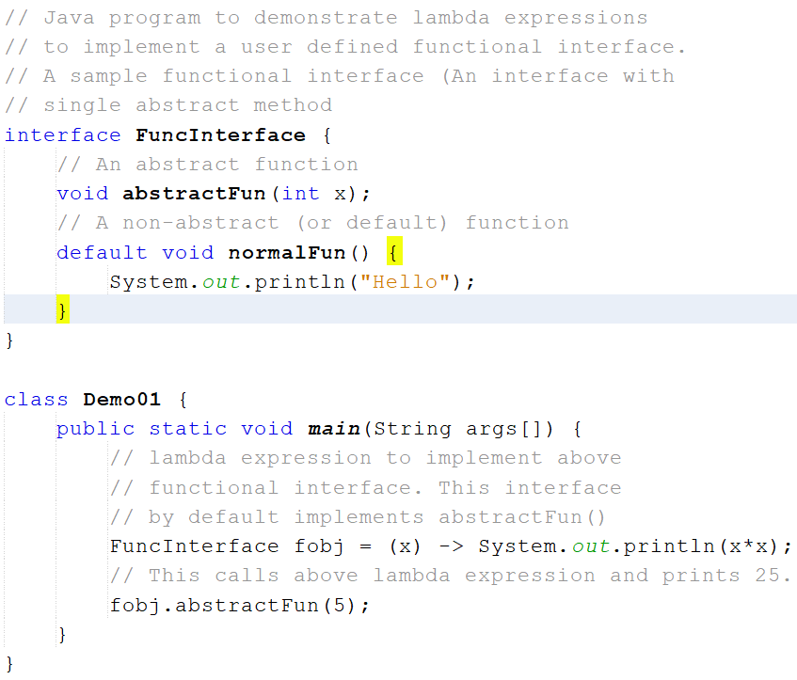
Lambda Expression (…)

Slide 26
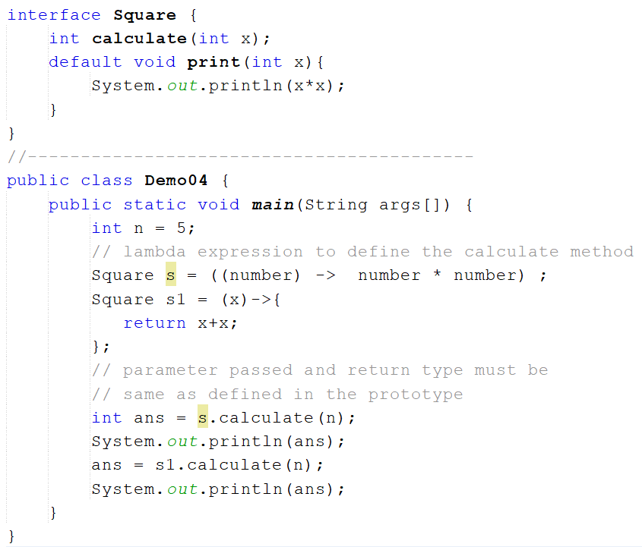
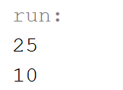
Lambda Expression (…)

Slide 27
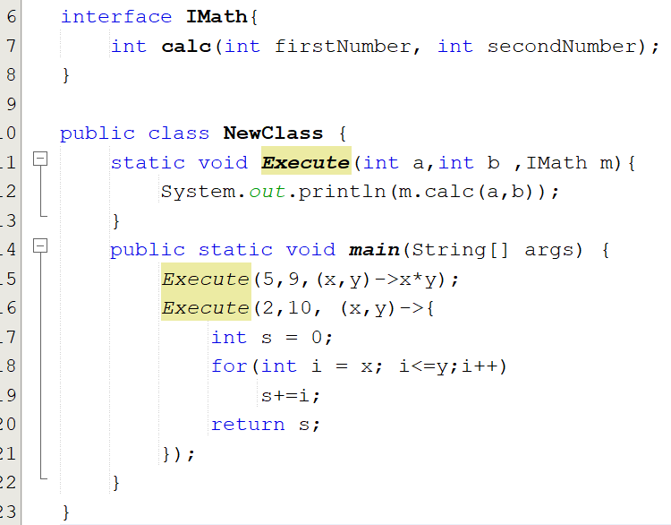

Lambda Expression (…)

Slide 28
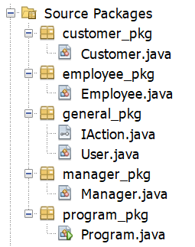
Using Abstract Class & Interface
Create a project as the follows :

Slide 29
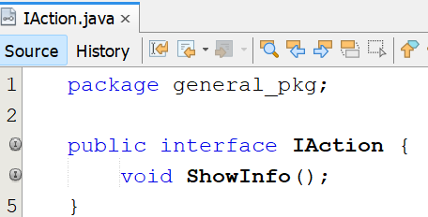

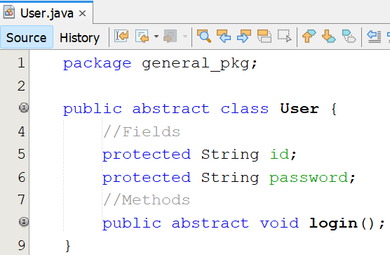
Using Abstract Class & Interface
Write codes for classes and interfaces :

Slide 30

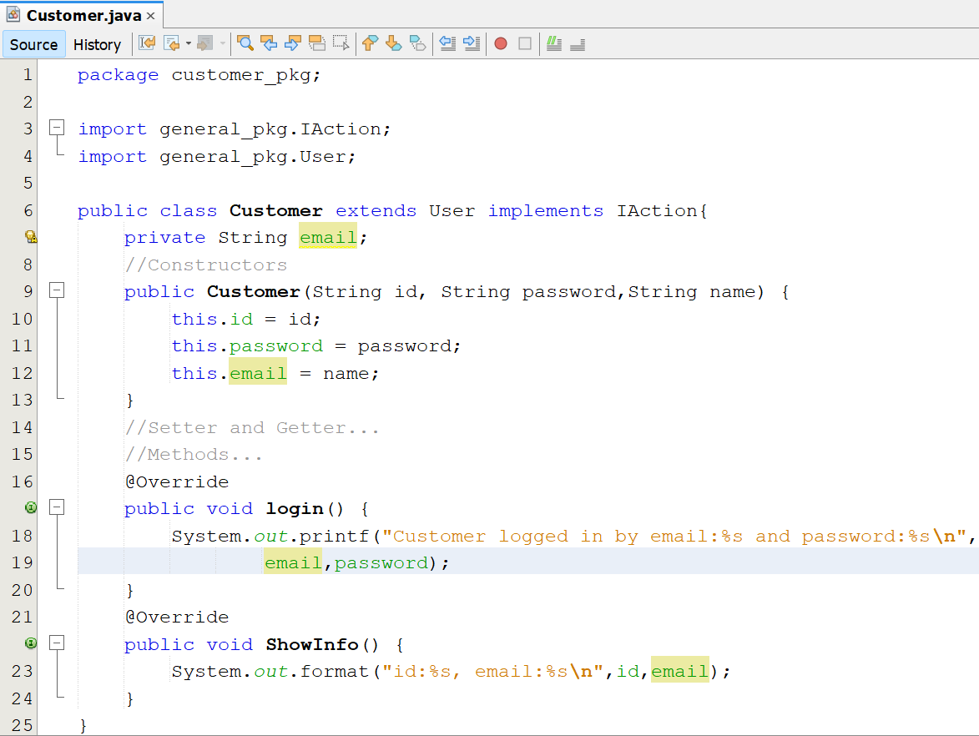
Using Abstract Class & Interface

Slide 31

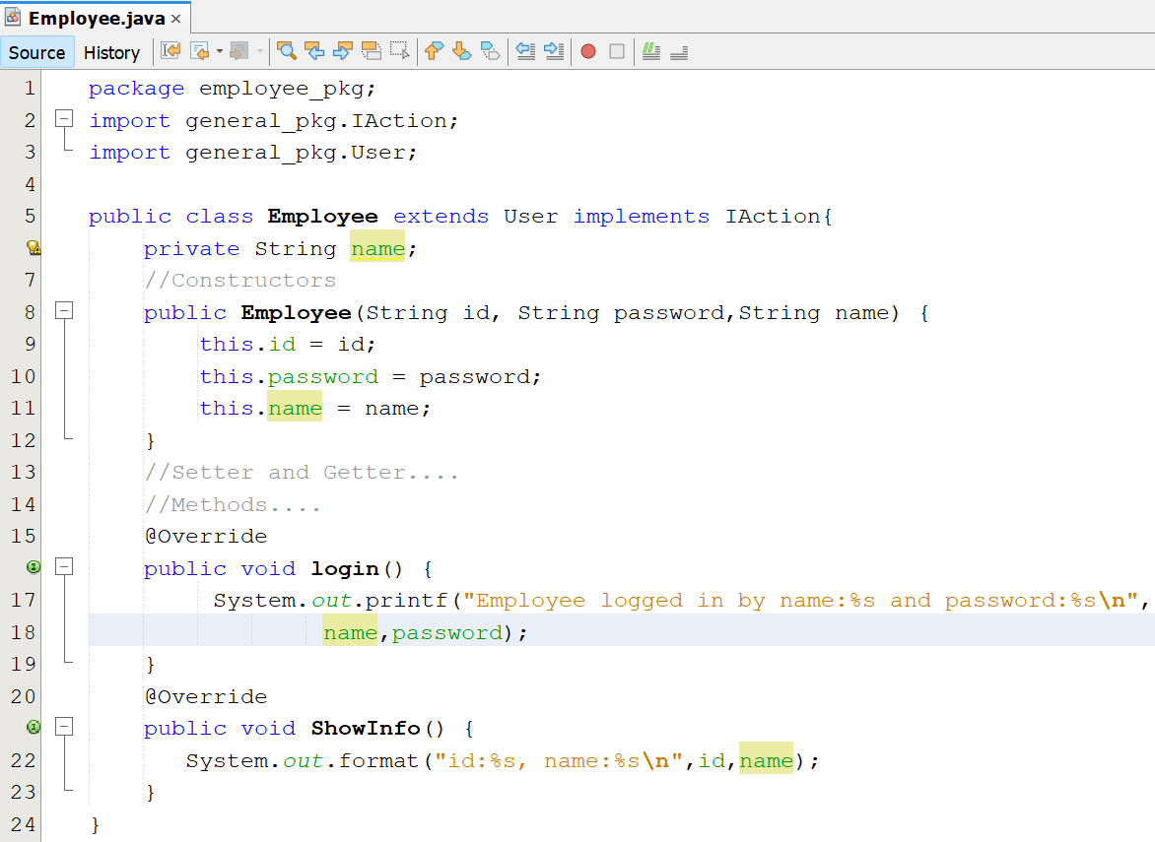
Using Abstract Class & Interface

Slide 32

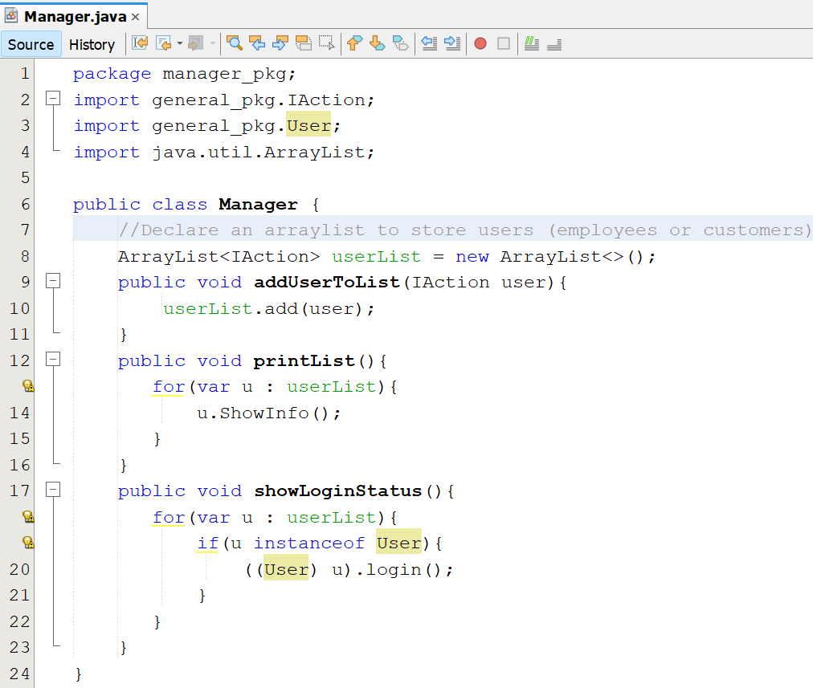
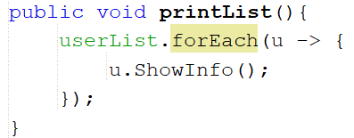
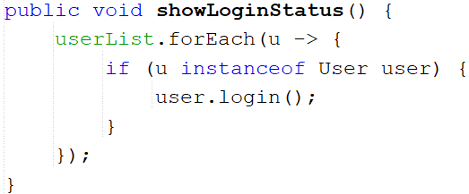
Using Abstract Class & Interface

Slide 33

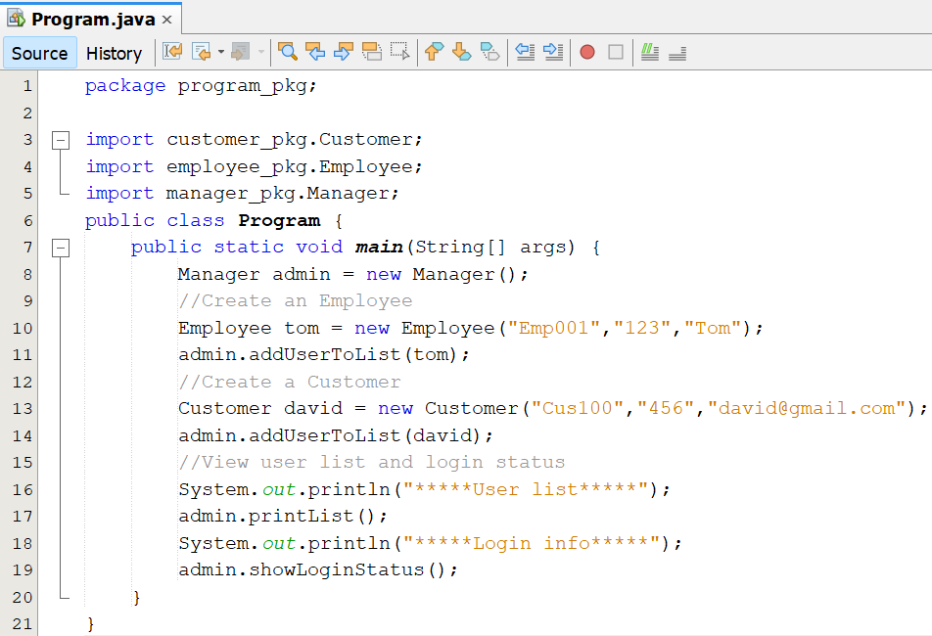
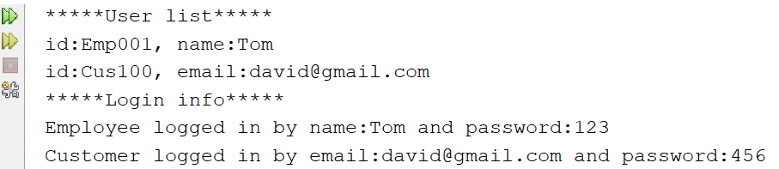
Using Abstract Class & Interface

Slide 34
Summary
Polymorphism is a concept of object-oriented programming
Polymorphism is the ability of an object to take on many forms
Overloading and overriding are a technology to implement polymorphism feature.
In OOP occurs when a parent class/ interface reference is used to refer to a child class object

